Slide 1
Robotics in Rehabilitation
Saurabh Kumar
21110187

Slide 2
Rehabilitation
Rehabilitation refers to giving aid, not necessarily medical, to physically handicapped or physically disabled people with biological impairments to help them achieve the kind of lifestyle they wish to have.
Rehabilitation engineering is when engineering principles are utilized to build devices and other technological solutions to assist the impaired.

Slide 3
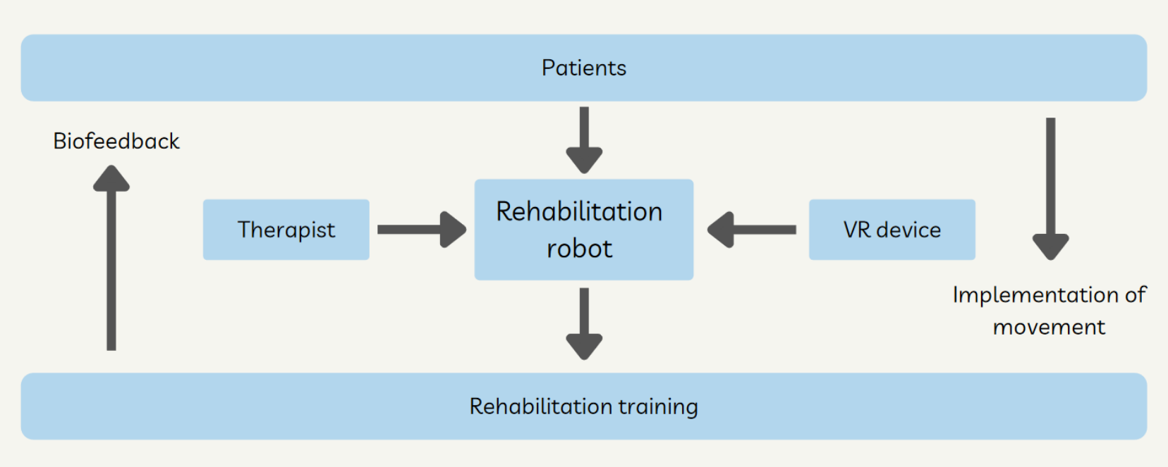
Role of Robotics in Rehabilitation

Slide 4
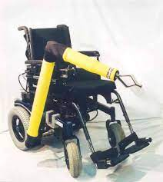
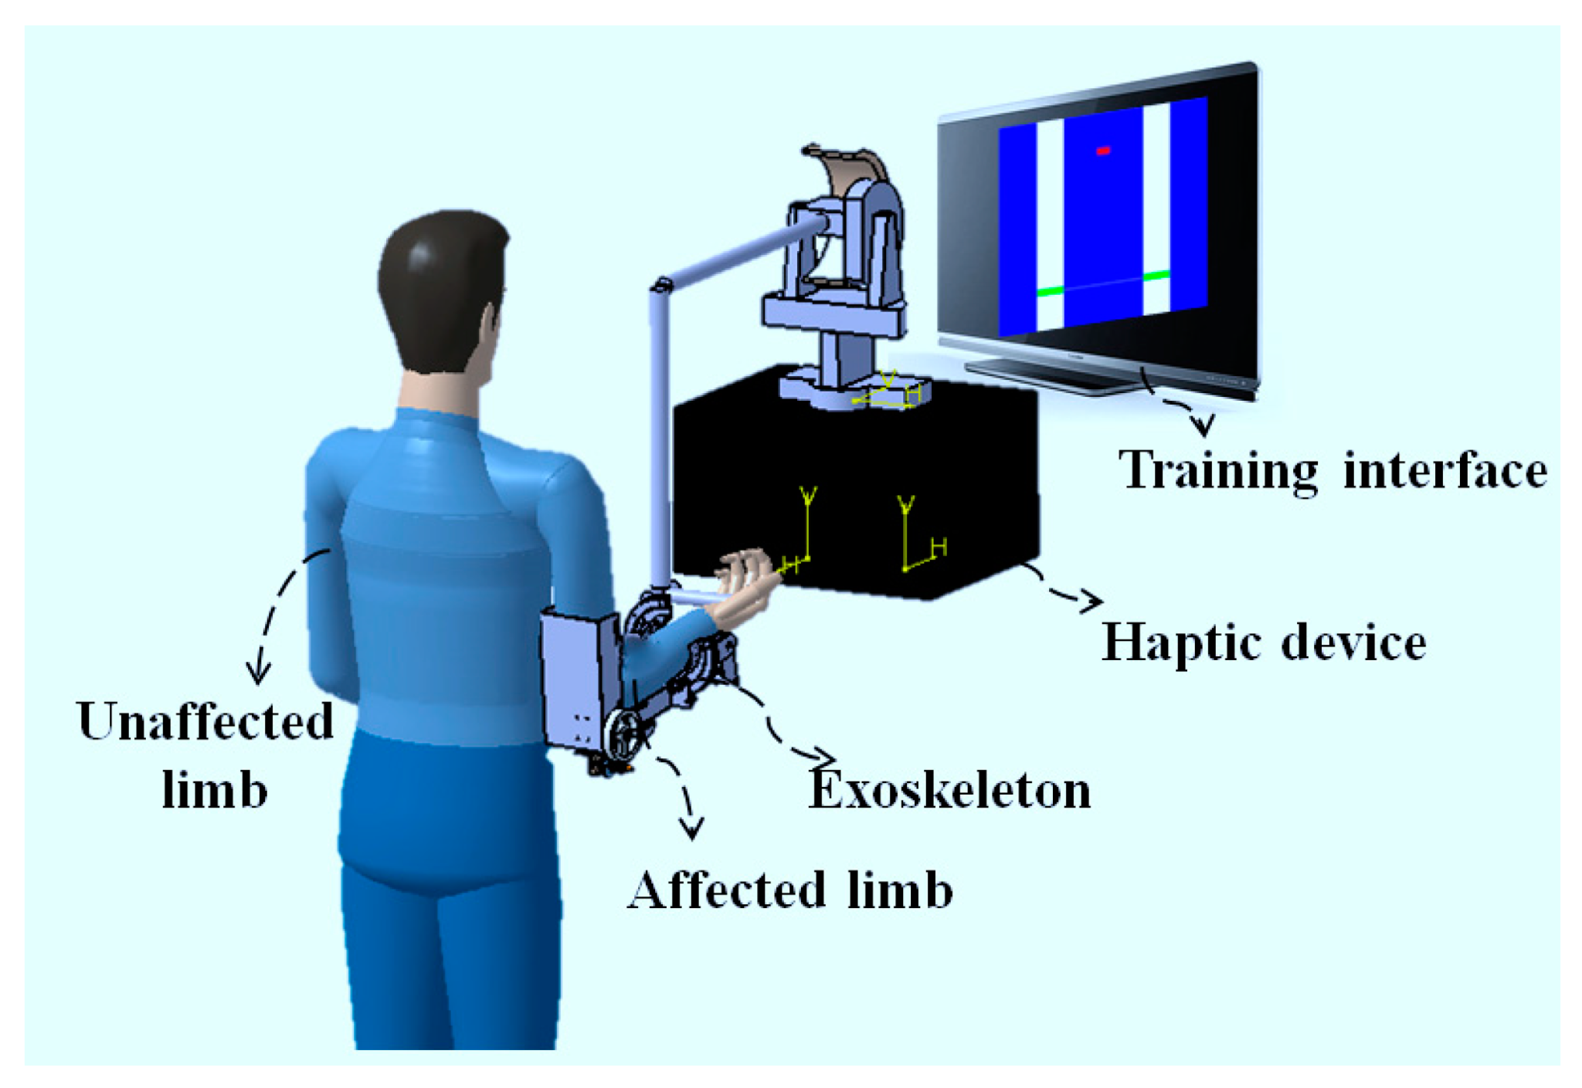
Types of Rehabilitation robots
[1]
An assistive robot that substitutes for lost limb movements ex: MANUS ARM(assistive robotic manipulator)
Therapy robot, also called a rehabilitator. Therapy robots are machines or tools for rehabilitation therapist that allow patients to perform practice movements aided by the robot. Ex MIT-Manus, helped stroke patients.
[2]

Slide 5
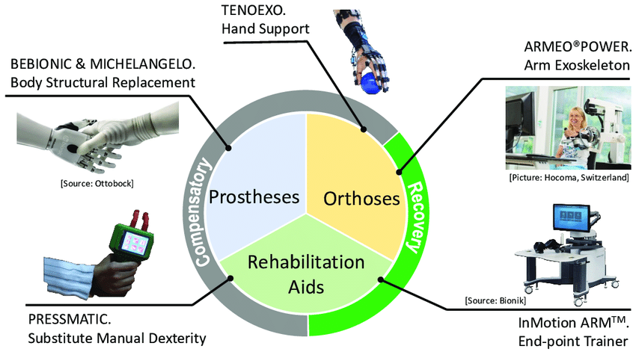
Device Morphology
[3]

Slide 6
Current State of the Art
Some current projects under rehabilitation include:
Functional Near-Infrared Spectroscopy Project
Tenoexo
Virtual peg insertion test.
A number of projects are currently underway to ensure that patients get more comfortable and these devices get more affordable.

Slide 7
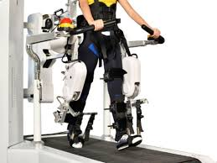
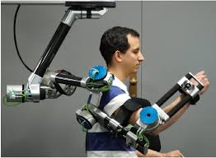
Limitations
Accessibility, ease of usage, and comfort are not up to the mark..
Relatively fewer and slower advancements.
Assistive robots can be quite bulky.
Rehabilitation devices are expensive and not affordable by everyone
The Insight Partners, “Rehabilitation Robots Market to witness huge growth in 2025 key player analysis: AlterG, inc., ekso bionics, hocoma, interactive motion technologies, bioxtreme robotics rehabilitation, instead technologies, kinestica,” openPR, 28-Sep-2018
 | Y. Zimmermann, A. Forino, R. Riener, and M. Hutter, “ANYexo: A versatile and dynamic upper-limb rehabilitation robot,” IEEE Robot. Autom. Lett., vol. 4, no. 4, pp. 3649–3656, 2019.

Slide 8
Future Prospects
The advancements include
Rehabilitation Robotics
Virtual Rehabilitation
Physical Prosthetics
Sensory Prosthetics
Brain Computer Interface
Modulation of Organ Function
Secondary Disorder Treatment

Slide 9
Thank you

Slide 10
References
[1] Ucf.edu. [Online]. Available: http://eecs.ucf.edu/~abehal/AssistiveRobotics/presentation/UCF_MANUS_ARM_082009.pdf.
[2] “Title: UCF-MANUS arm MANUS arm,” Google.com. [Online]. Available: https://www.google.com/imgres?imgurl=x-raw-image%3A%2F%2F%2F3b3f6ac8cd66685f07560acce42e2732f26c496b0695fe45cb11e7d69763e327&imgrefurl=http%3A%2F%2Feecs.ucf.edu%2F~abehal%2FAssistiveRobotics%2Fpresentation%2FUCF_MANUS_ARM_082009.pdf&tbnid=X2hmzchqPzvP9M&vet=12ahUKEwiKt8GdwvD2AhW9W2wGHb7vDDAQMygAegUIARC7AQ
[3]https://www.researchgate.net/publication/334040594/figure/fig1/AS:774099349549063@1561571075633/Rehabilitation-robotics-domain-according-to-device-morphology-and-expected-role-it-plays.png
[4]https://relab.ethz.ch/research/current-research-projects/interfacing-the-brain-using-functional-near-infraredspectroscop.html
[5]https://www.nibib.nih.gov/science-education/science-topics/rehabilitation-engineering https://www.sciencedirect.com/science/article/pii/S1350453319301675
[6]https://www.medicaldevice-network.com/features/future-prosthetics/ https://books.google.co.in/books? id=xOTMZKIh71sC&lpg=PA1&ots=q0UmGez9nQ&dq=introduction%20to%20rehabilitation&lr&pg=PR10#v= onepage&q=introduction%20to%20rehabilitation&f=false https://www.researchgate.net/publication/334040594/figure/fig1

